Slide 1

Fundamental Prompting Techniques in AI and LLMs
Master the art of communicating with large language models through strategic prompt engineering.

Slide 2

What is Prompting?
Prompting is the practice of crafting clear, specific instructions to guide large language models toward desired outputs. Think of it as the interface between human intent and AI capability—your words shape what the model produces.
Input
Process
Your carefully designed question or instruction
Model analyzes context and patterns
Output
Tailored response based on your prompt

Slide 3

Why Prompting Matters
The quality of your prompt directly determines the quality of your output. Small changes in wording can dramatically shift results—from generic to exceptional. Effective prompting unlocks the full potential of modern AI systems like ChatGPT, Claude, and Copilot.
1
Precision
Clear prompts reduce ambiguity and misinterpretation
2
Efficiency
Well-structured requests yield better results faster
3
Control
Guide tone, format, and complexity with intentional language

Slide 4


Zero-shot Prompting
Zero-shot prompting asks the model to complete a task without any examples. The model relies solely on its training and the instruction you provide. It's the simplest approach and works well for straightforward requests.
Example: "Explain quantum computing in simple terms." The model generates an explanation without seeing prior examples.
✓ Best For
General knowledge, straightforward tasks, brainstorming
⚠ Limitation
May lack specificity or miss nuanced requirements

Slide 5


One-shot Prompting
One-shot prompting provides a single example of the desired format or style. The model learns the pattern from this one example and applies it to your actual request. This dramatically improves consistency and quality.
Example: Show the model one customer complaint response, then ask it to respond to a new complaint in the same style and tone.
One Example
Provides pattern recognition and style guidance for the model
Better Results
More consistent output than zero-shot, simpler than few-shot

Slide 6



Few-shot Prompting
Few-shot prompting provides multiple examples (typically 3-5) demonstrating the desired behavior. This is the most powerful technique for achieving consistent, high-quality outputs, especially for complex or specialized tasks.
Example: Show 3 product reviews with your desired sentiment analysis format, then ask the model to analyze a new review using that format.
Superior Performance
Pattern Learning
Context Rich
Achieves best results for complex tasks and specialized domains
Model infers structure, style, and content expectations from examples
Works exceptionally well with domain-specific or technical content

Slide 7
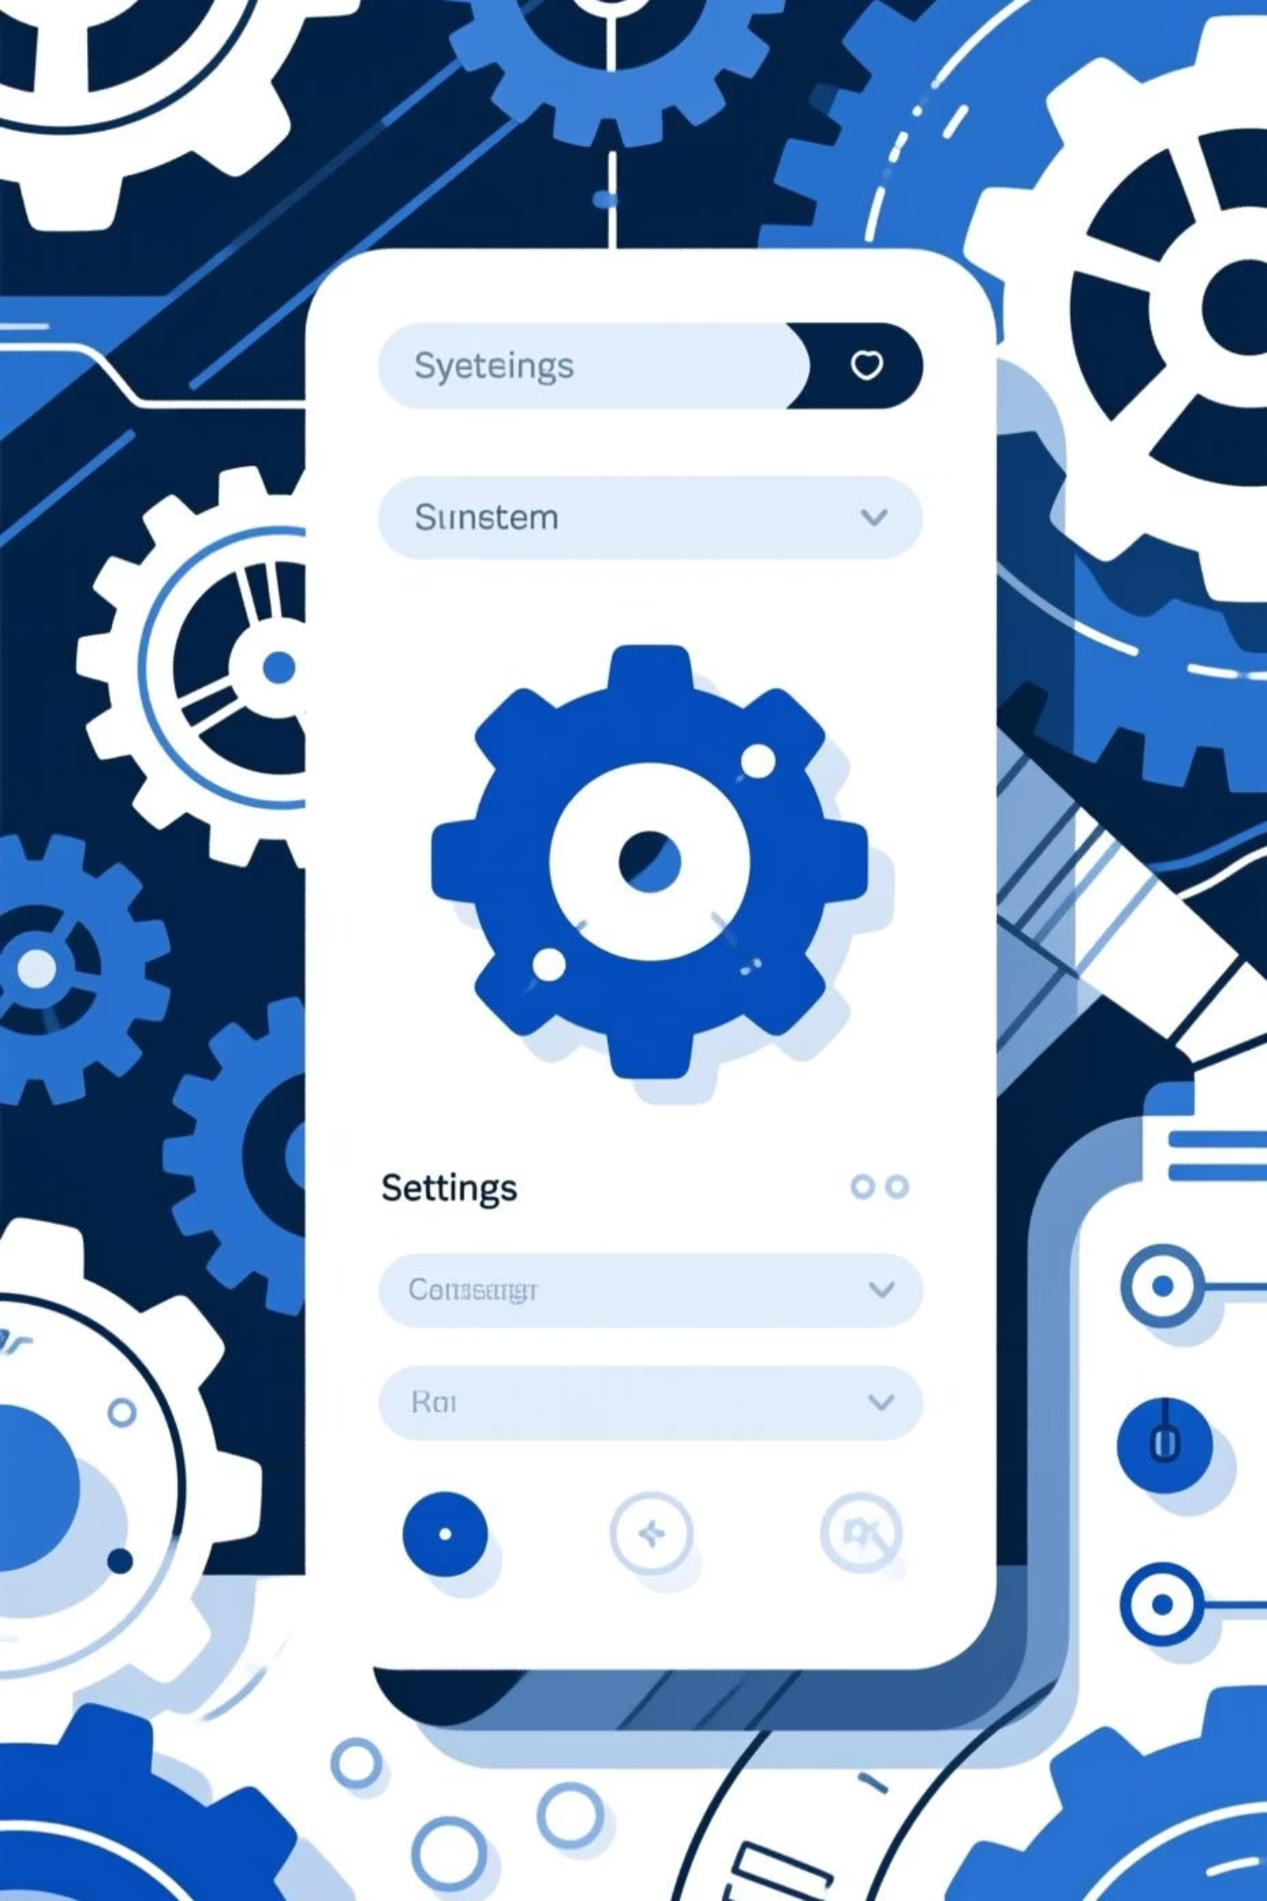

System Prompting
System prompting sets the foundational behavior and personality of the model through a separate instruction layer. Unlike user prompts, system prompts define character, values, and constraints that apply to all subsequent interactions.
Example System Prompt: "You are a helpful coding assistant. Always explain your code. Prioritize clarity over brevity. Ask clarifying questions when needed."
Define Role
Set Constraints
Establish what the model represents
Define boundaries and limitations
Shape Behavior
Control tone and interaction style

Slide 8


Role-based & Contextual Prompting
Role-based Prompting
Contextual Prompting
Ask the model to assume a specific persona or expertise level. "Act as a marketing strategist..." or "Respond as an experienced developer..." guides the model's response style and knowledge application.
Provide relevant background information, constraints, and requirements upfront. Rich context helps the model make informed decisions and generate more appropriate responses aligned with your specific situation.
Example: "Act as a UX researcher. Design a user research plan for a mobile banking app."
Example: "Context: Our audience is developers. Write a feature announcement for an API endpoint in technical language."

Slide 9

Common Prompting Mistakes
Vague Instructions
Unclear prompts yield unclear answers. Specificity drives quality results.
Missing Context
Insufficient background information leads to generic or off-target responses.
Contradictory Requirements
Conflicting instructions confuse the model. Clarify priorities and trade-offs.
Ignoring Format Needs
Not specifying desired output format leads to misaligned responses.

Slide 10
Mastering Prompt Engineering
Effective prompt engineering combines clarity, context, examples, and iteration. Start simple, test outputs, refine based on results, and build a library of successful prompts for your workflows.
Be Specific
Include details, constraints, and desired outcomes in your prompt
Provide Context
Background information helps models make better decisions
Use Examples
Few-shot prompting dramatically improves consistency
Iterate & Test
Refine prompts based on output quality and adjust as needed
Apply Everywhere
Use these techniques with ChatGPT, Claude, Copilot, and beyond

Slide 11
MIXTURE OF EXPERT (MOE)
Mixture-of-Experts (MoE) is a special type of AI model architecture where different “experts” handle different types of tasks.
1
a math expert
2
a coding expert
3
a writing expert
4
a reasoning expert

Slide 12
How MoE Works
The model receives a question.
A router decides which expert(s) should answer.
Only those experts get activated.
Their responses are combined → final answer.
Faster
Larger capacity
More specialized
because not all experts are used every time
model can store more knowledge
each expert focuses on a skill

